Slide 1

RAMEN HOUSE
Restaurant Website Project Report
San Jose State University
Professor: Subhankar Dhar
BUS4 118W - Section 1
Presented by: Dustin Le
Edwin Tu
Joey Hoang
Thanh Luu

Slide 2
Contents
1. Introduction
2. Outline of the project
3. Discuss requirements, market research, key features, etc.
4. Technology platform
5. Sitemap
6. User Interface Design
7. Conclusions
8. Who contributed to what?
9. Demo

Slide 3
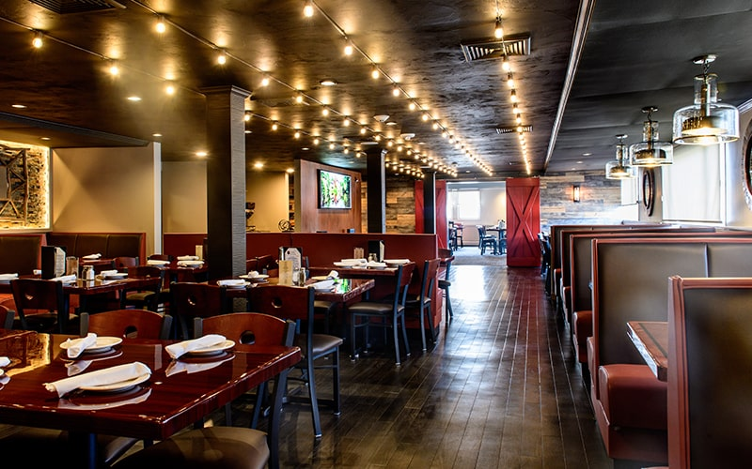
Introduction
Mission Statement
Increase engagement and traffic for a business
Spotlight the company’s specialities
Notes:
(Joey)

Slide 4

Timeline
Work Breakdown Structure
Completing Deliverables
Testing & Launch
Phase 1
Phase 2
Phase 3
Establish requirements
Create deliverable dates
Assess and assign responsibilities
Breaks down tasks into manageable iterations
Keeps project on schedule
Mitigates risk of code error
Ensures reliability
Opportunity to receive user feedback on UI
Notes:
(Dustin)
The 3 phases of our timelines are listed as phase 1 being the WBS, 2nd is completing all deliverables, and 3rd phase is final testing and launch.
In phase 1 we establish the project requirements. We create a strategically planned deliverable schedule and sitemap that keeps us on track for final launch. The deliverables and sitemap also support our group in delegating responsibilities and making sure we address the requirements of the project.
Phase 2 is about completing deliverables. The project is strategically broken into deliverables so our group can put quality work without rushing the project. Having deliverables and new versions of our site also acts as a contingency plan that prevents data loss and delays.
Phase 3 is where we test and launch our site. We look back to our sitemap and report to see if we address the necessary requirements for this project. Phase 3 is also an opportunity to receive user feedback on how to improve the UI

Slide 5
Requirements
Home Page
Reservation
Contact Information
Online Menu with:
Main Course
Appetizers
Desserts
Drinks
Order food and drinks online
Purchase Online
Special Orders
Confirmation Emails once order/reservation is complete
Notes:
(Joey)

Slide 6

Key Features
Online Menu/Order Page
Ability to create Reservations
Location Page with google maps
Contact Information
About Us Page
Nutritional Information Page
Notes:
(Joey)

Slide 7

Market Research
A website can
Provide low advertising costs
Share key information
Customer feedback
Increase engagement and traffic
Increase revenue
Create competitive advantage
Competition
Ramen Nagi
Kenzo (Sushi)
SomiSomi (Dessert)
Notes:
Dustin

Slide 8
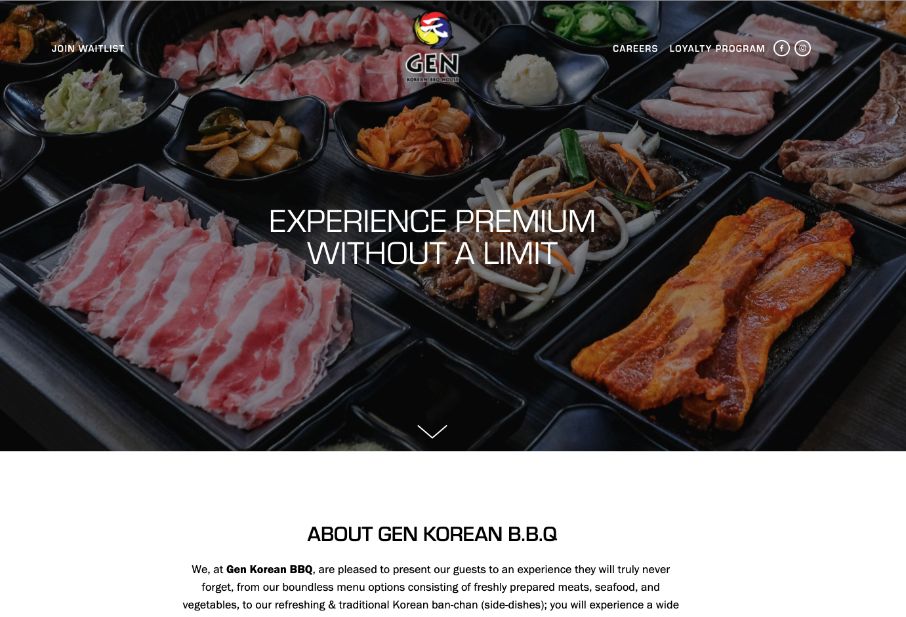
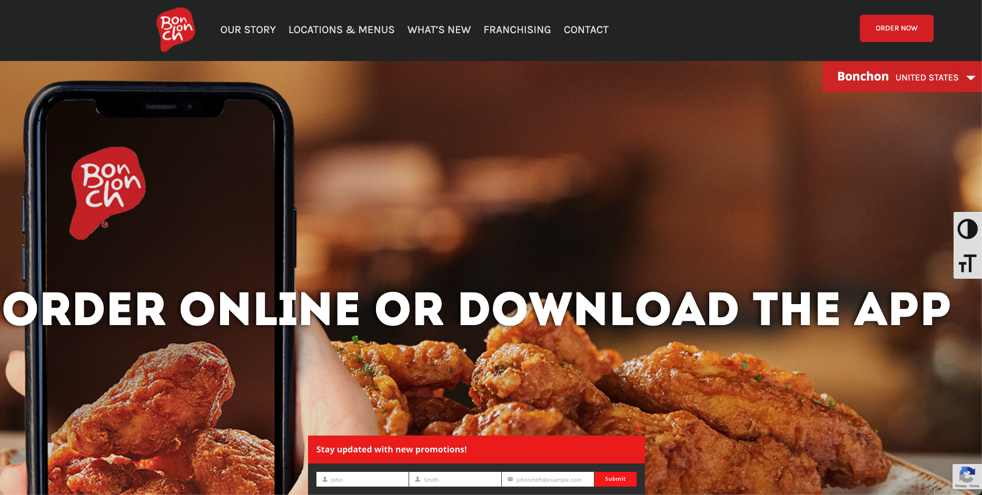
Market Research
Notes:
Dustin

Slide 9

Technology Platform
Hyper Text Markup Language (HTML)
Cascading Style Sheets (CSS)
Javascript (JS)
Bootstrap
Zoom
Google Drive
GitHub
PayPal
Notes:
Edwin
The technology platforms we utilized were HTML. With HTML, we wrote the bulk of our code in it. With CSS, we made the aesthetic of the website and how it was going to look. We also used Javascript which had the main functions of our website, which were the reservation, shopping cart, and support page. The javascript was a higher level of code that updates to how the user interacts with the website. We also used bootstrap, zoom, google drive, github, and paypal while making the website for their various of functions.

Slide 10
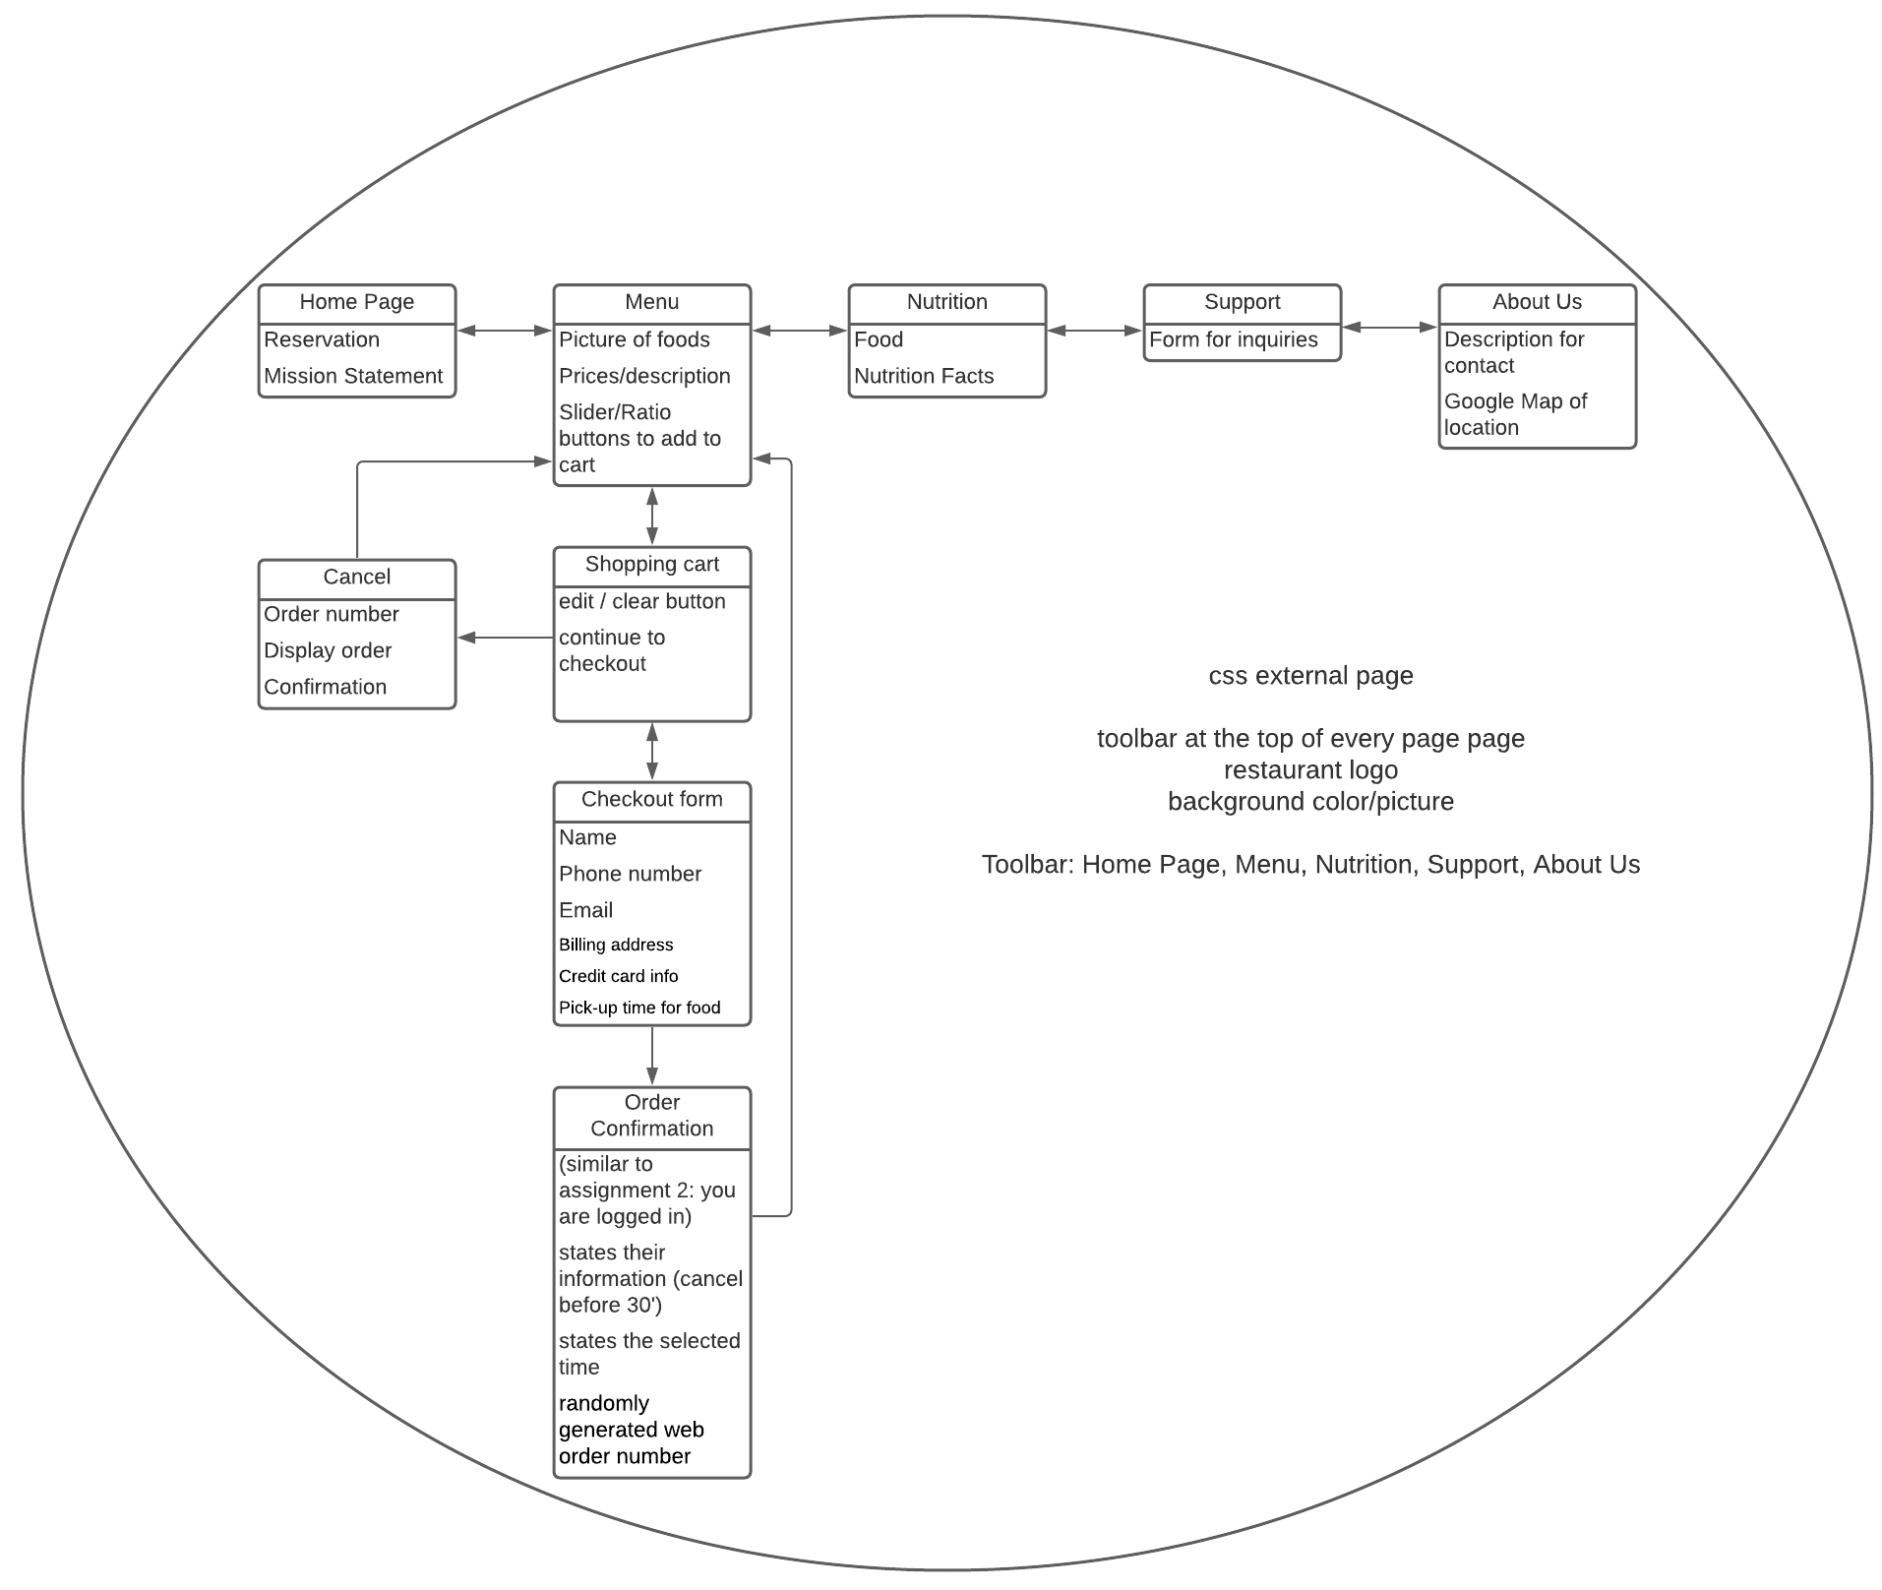
Sitemap
Notes:
EDwin
This is our sitemap. This is the basic layout of the website we wanted to do. Along the top are the 5 main pages of the website. There is home page, menu, nutrition, support, and about us. Within the menu page, we have our menu alongside our shopping cart. We are able to cancel the shopping cart at any time and be brought back to any of the 5 pages. If we were to progress further with the shopping cart, we would get to the checkout form and order confirmation page. In future updates we would like to fully implement the the checkout form and order confirmation page, but at the moment, we have an alert letting the customer know that their order has been placed.

Slide 11



Users Interface Design
Use CSS and Bootstrap to design:
Background color (main parts):
Header and foot color:
Color text:
Head link: Home, Menu, Support.
Left and right: Not implement - 0.
Foot link: Reservation.
Shape:
Text and style:
https://fonts.google.com/
Big Shoulder Text: 100-900.
Cursive
Picture: Jpg,jpeg.
Notes:
This is our visual elements which we used for our UI design. We used CSS and Bootstrap for creating our pages. The main colors for 5 main pages of the website is grey (triple 218) and white. In each page, user can see the header and foot with different colors as black background and white text. Header contains links of Home, Menu, Support, Nutrition, and About us. Foot always show the business information and reservation link. Rectangle and square in our main shapes. We also import Big Shoulder Text of google.
https://fonts.google.com/
In the next slide, we will show our wireframe and mockup.

Slide 12
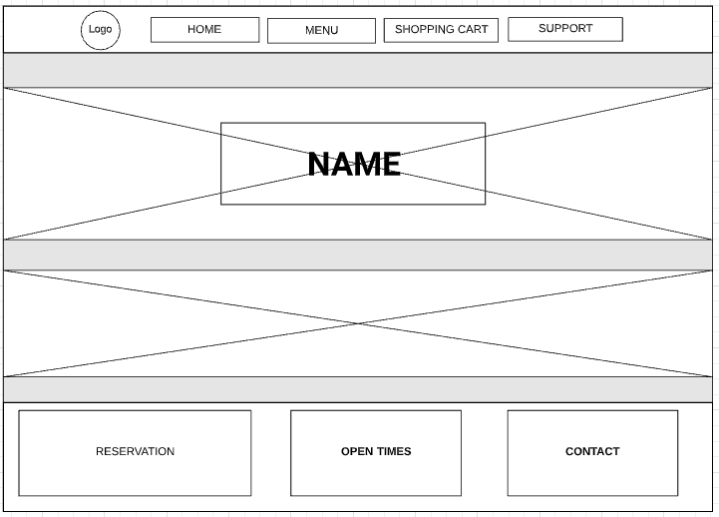
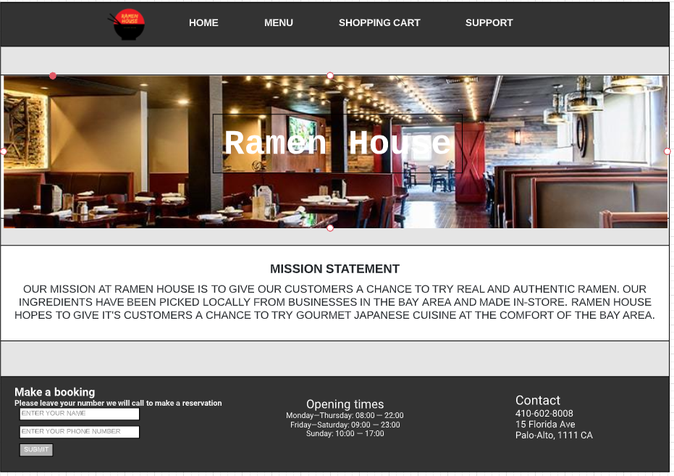
Users Interface Design
Notes:
It is here our wireframe. We use white and grey in main parts for each pages, and the item/contain is center.
We also create whitespace in (gray) that helps users can see our pages and concentrate in items.
Z-layout is also implemented in our pages that helps users catch main point easier.

Slide 13
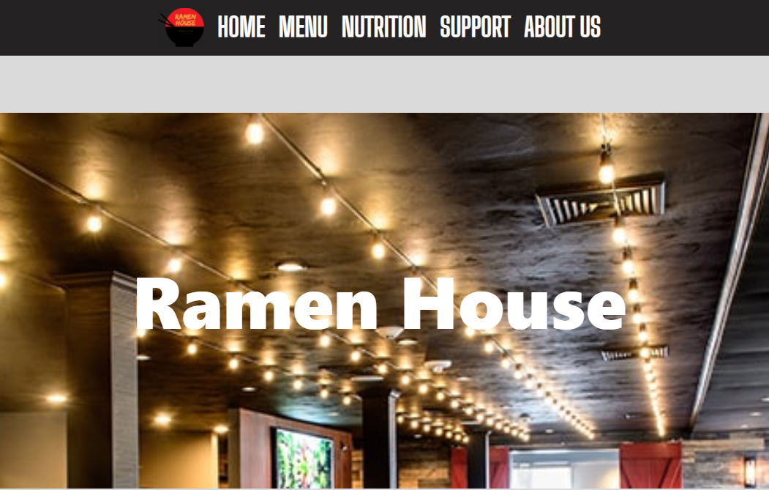
Users Interface Design
Header displays:
display: flex;
flex-direction: row;
justify-content: center;
position: absolute;
z-index: 100;
left: 0;
width: 100%;
padding: 0;
background:#242222;
Notes:
Header and footer will be appear in 5 main pages. we use the color in back, with flex row. To keep the contents absolutely in row.
Item, contents will be presented and justify in center,

Slide 14
Users Interface Design
Home, Menu, Nutrition, Support and About us:
.nav-flex-row li a {
font-family: 'Big Shoulders Text', cursive;
color: rgb(255, 255, 255);
font-size: 3.5em;
text-transform: uppercase;
font-weight: 800;
Notes:
Thanh

Slide 15

Users Interface Design
.nav-flex-row li a:hover{
background:rgb(218, 218, 218);
Notes:
Thanh
Create effective user experience,
We use the hover sector in our header (css). When users click or move a mouse (point) to selection on header that will change the color to grey.

Slide 16
Users Interface Design
Create Whitespace:
.section-break{
height: 250px;
padding-top: 50px;
display: flex;
flex-direction: column;
justify-content: center;
align-items: center;
background: rgb(218, 218, 218);
Notes:
To make users concentrate our items. We create the whitespace (in grey (218, 218. 218)).

Slide 17
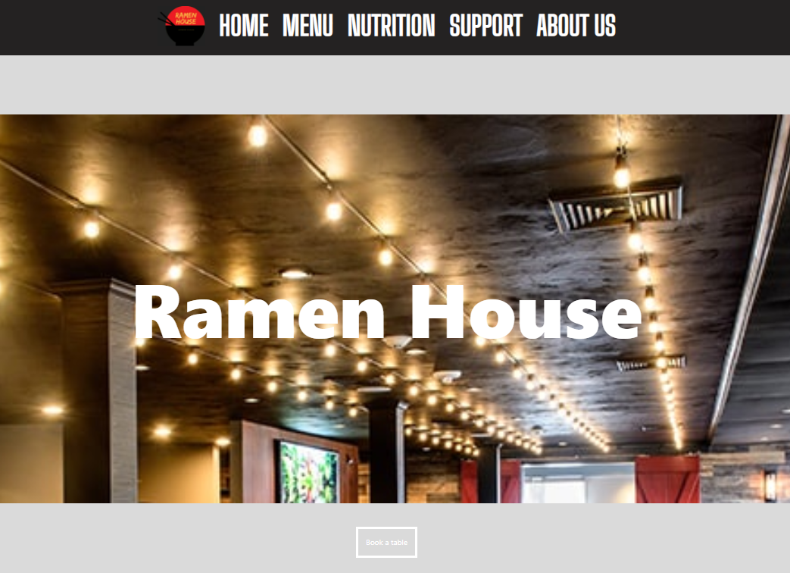
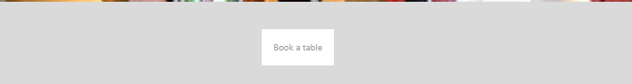
Users Interface Design
Use the same code for section book:
.section-book {
height: 150px;
padding-top: 50px;
display: flex;
flex-direction: column;
justify-content: center;
align-items: center;
background: rgb(218, 218, 218);
Color & border: white
Display: block
Effective-hover.
Change from grey to white.
Notes:
Similar to white space code for a book table in home page.
We also implement the effective as Hover for “Book A table” button. When user click book a table, the color will change from grey to white.

Slide 18
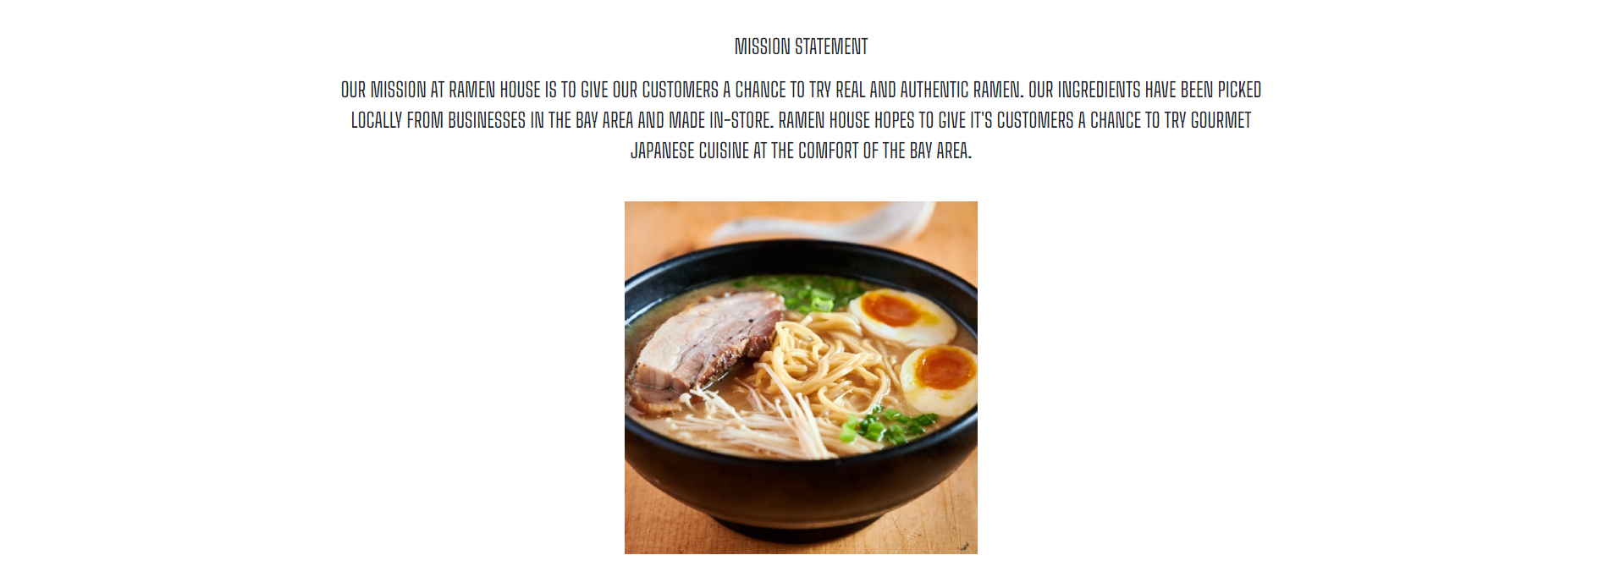
Users Interface Design
.section-intro h1 {
text-align: center;
color:white;
font-size: 10em;
font-weight: 800;
.about-section h3 {
text-align: center;
width: 60%;
margin: auto;
font-family: 'Big Shoulders Text', cursive;
font-size: 1.8em;
text-transform: uppercase;
.section-intro header {
display: flex;
flex: 4;
flex-direction: row;
justify-content: center;
align-items: center;
Notes:
To attract users, we use white in another section that contrast with grey. For example, in mission and about us section. We use white background, the content/items display in center and flex row.
We apply font Big Shoulder for Google to introduce about Mission and About us.
In the mission. With Bootstrap, we use Carousel. A slideshow component for cycling through elements.
It is our example, Edwin and Dustin express more in our demo.

Slide 19
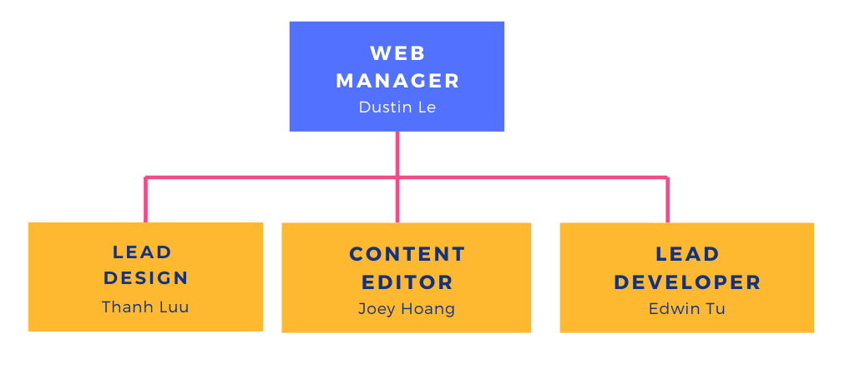
Project Organization Diagram
Notes:
Edwin
This is our project organization diagram, Dustin was our web manager. He was basically in charge of directing orders and helped us out whenever we needed. Thanh was the lead designer. Thanh created the initial css page where everyone built off of it. She was the one that created all of the mock designs and created how the website would look. Joey was the content editor. He was the one that looked over everyones code to make sure everything was right and if there was any bugs or mistake he would change it. Joey worked alongside me as I was the lead developer. We both worked together to write out the code for the website. Everyone wrote some code for the website so everyone had an equal amount of work and contribution with this project.

Slide 20
Conclusion
Stakeholder point of view
Focused on user experience and interface
Created deliverable dates to stay on schedule
Created contingency plans to mitigate probability of errors/delays
Notes:
Edwin
While building the website, we wanted to have the stakeholders point of view in mind. We understand that our customers, which are our stakeholders, makes our business successful so we put ourselves into their shoes as we built this site. We wanted to focus on user experience and interface so it would be simple and easy for the customers to navigate throughout the website. As we were working on the website, we created deliverable dates to stay on schedule so we do not fall behind. We created backup plans to mitigate any chances of errors or delays.

Slide 21
Demo
We will be presenting a demonstration of our website

Slide 22
Thank you for listening to our presentation
Any Questions?

